Slide 1
Hotel Booking Cancellations: Analysis and Optimization

Slide 2
Business Problem
In recent years, both City Hotel and Resort Hotel have experienced high cancellation rates, leading to reduced revenue and suboptimal room occupancy. As a result, their primary objective is to minimize cancellations to enhance revenue generation and operational efficiency. Our goal is to provide comprehensive business insights to help address this issue.
This report focuses on analyzing hotel booking cancellations and other factors that do not significantly impact their business or annual revenue.

Slide 3
Assumptions
No significant events between 2015 and 2017 have notably impacted the data used.
The data remains relevant and can effectively support hotel planning and decision-making.
There are no unexpected drawbacks to implementing the recommended strategies.
Currently, the hotels have not adopted any of the proposed solutions.
Booking cancellations are the primary factor affecting revenue generation.
Cancellations lead to unoccupied rooms for the reserved duration.
Guests cancel their bookings within the same year they make reservations.

Slide 4
Research question
What factors influence hotel reservation cancellations?
How can hotel reservation cancellations be reduced?
How can hotels be supported in making pricing and promotional decisions?

Slide 5
Hypothesis
Higher prices lead to an increase in cancellations.
Customers are more likely to cancel when the waiting list is longer.
Most clients make their reservations through offline travel agents.

Slide 6
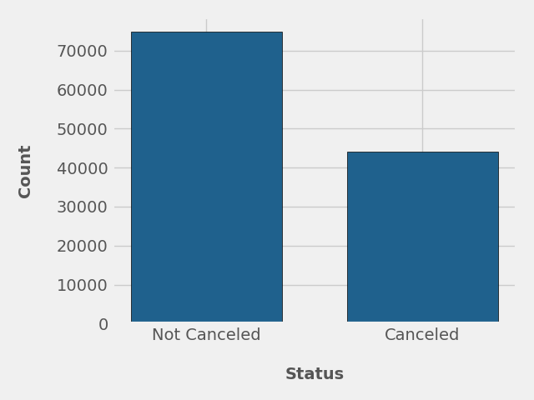
Analysis and findings
The bar graph shows the percentage of canceled and non-canceled bookings. While many reservations were not canceled, 37% of clients canceled their bookings, which greatly impacts the hotel's earnings.

Slide 7
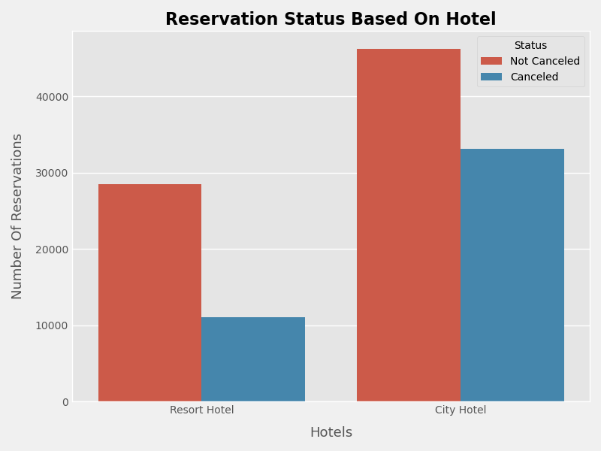
In comparison to resort hotels, city hotels have more bookings, It’s possible that resort hotels are more expensive than those in cities

Slide 8
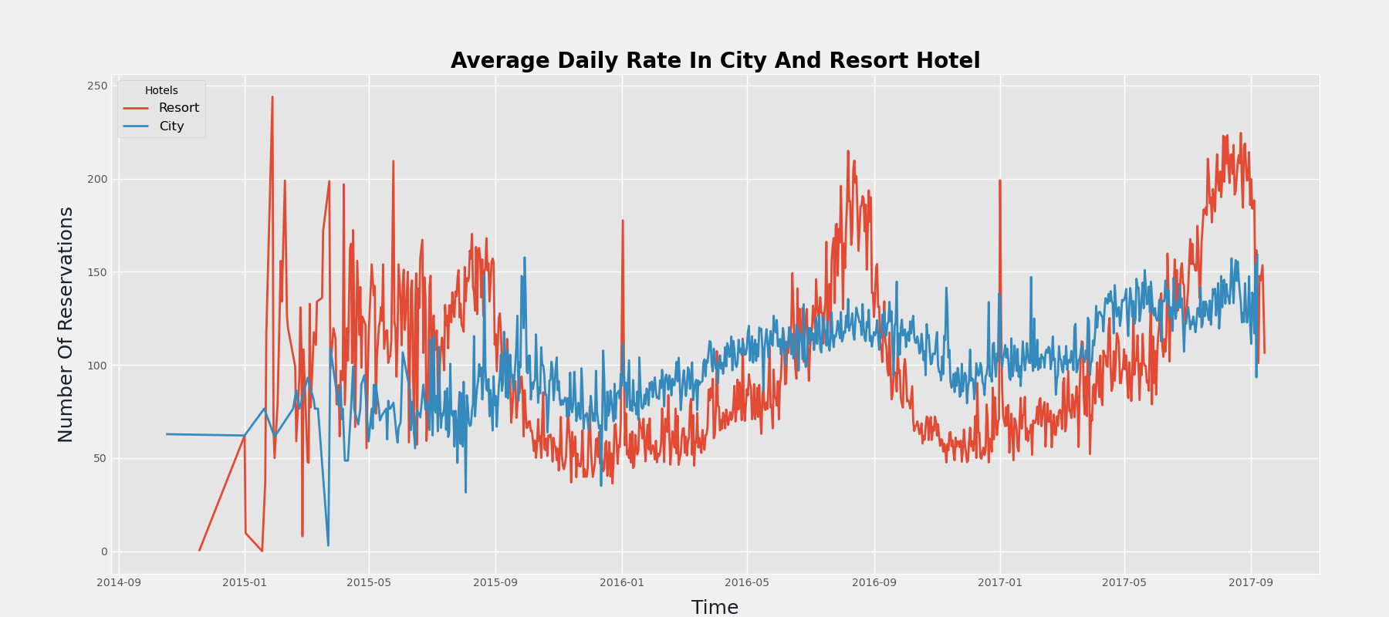
The line graph shows that on some days, the average daily rate of the city hotel is higher than the resort hotel, while on other days, it is lower. Weekends and holidays likely cause an increase in resort hotel rates.

Slide 9
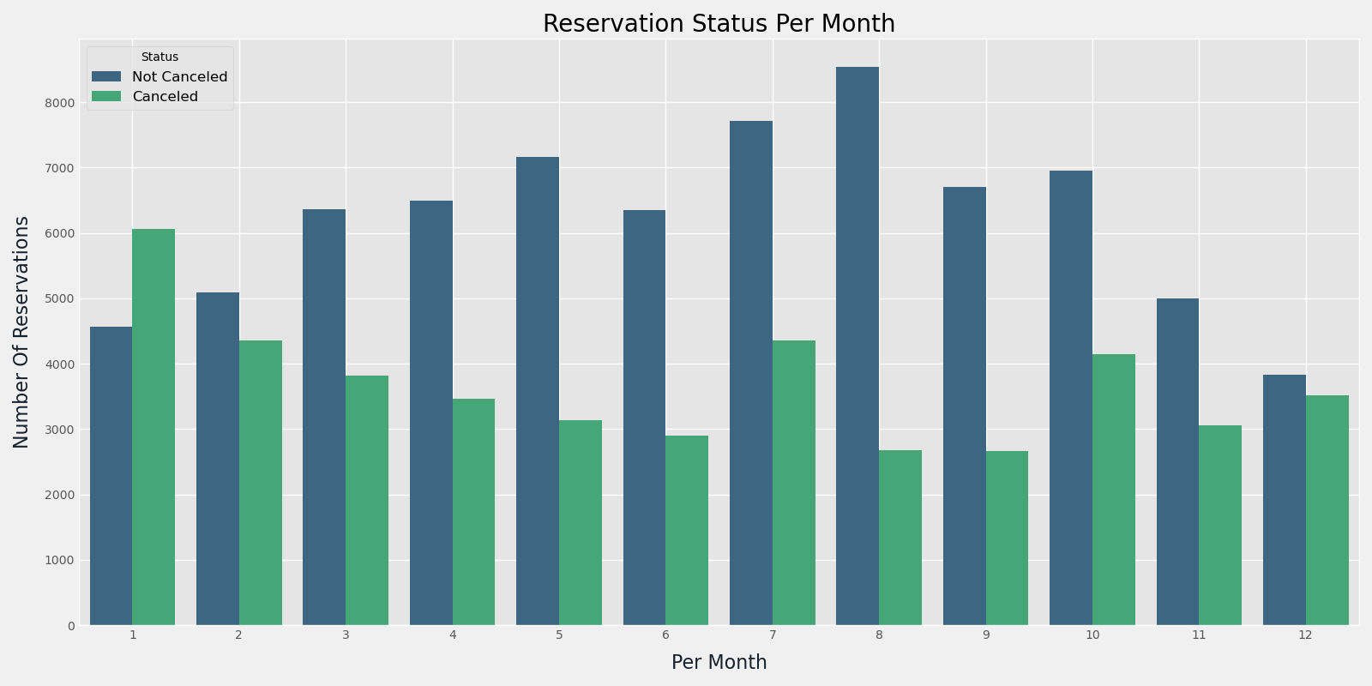
We developed a grouped bar graph to examine the months with the highest and lowest reservation levels based on reservation status. The graph indicates that both confirmed and canceled reservations are highest in August, while January has the most cancellations.

Slide 10
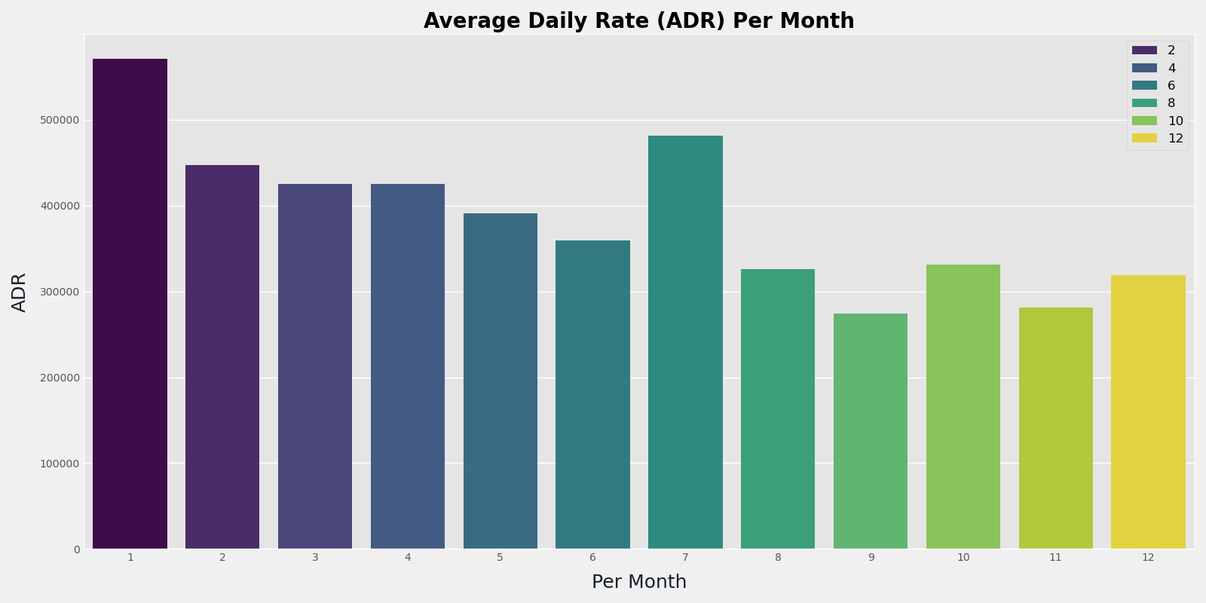
This bar graph shows that cancellations are highest when prices are at their peak and lowest when prices are lower. This suggests that the cost of accommodation is the main factor influencing cancellations.

Slide 11
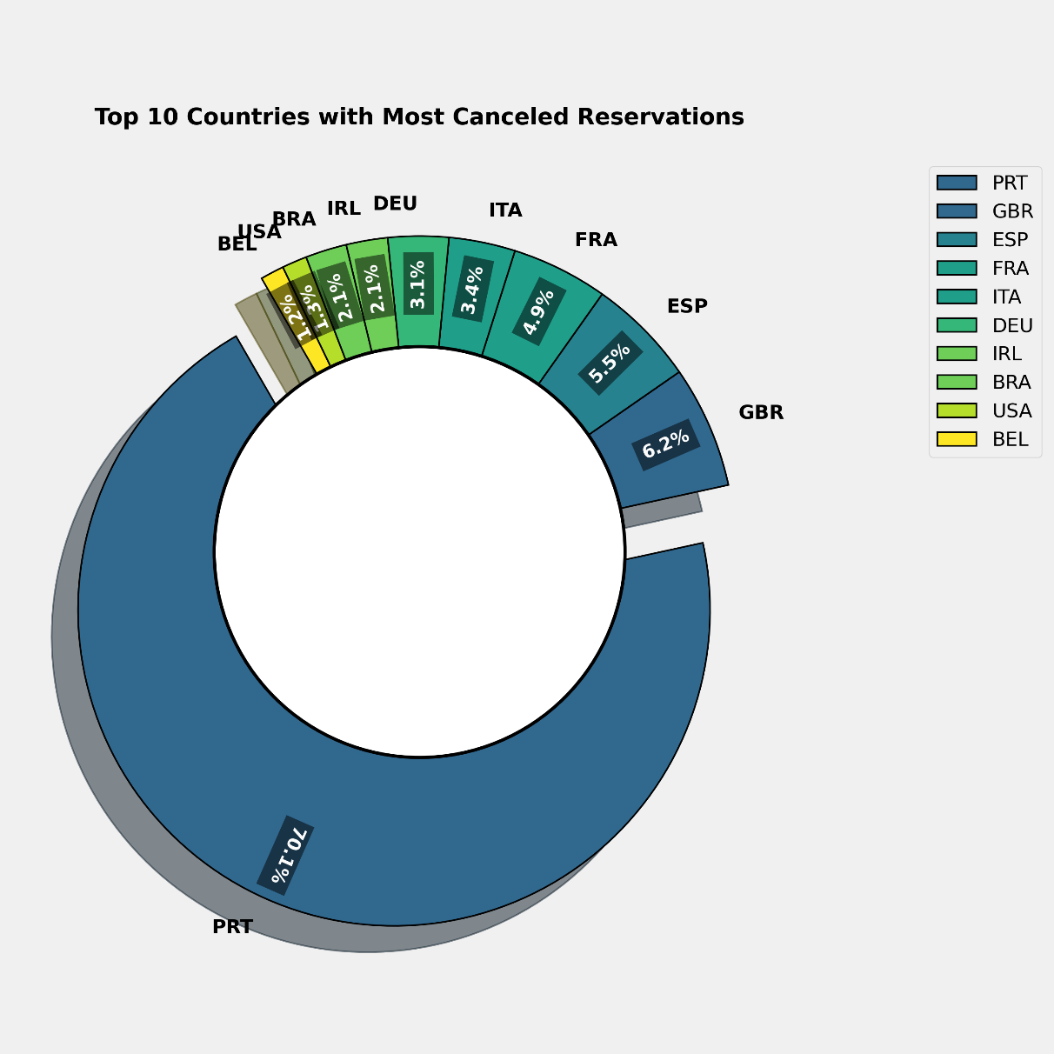
Now, let's identify the country with the highest reservation cancellations. Portugal ranks first with the most cancellations.

Slide 12
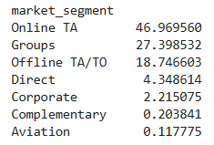
Let's examine where hotel guests are booking their reservations. Are they coming from direct visits, groups, online travel agencies, or offline travel agents? Around 46.96% of clients book through online travel agencies, while 27.39% come from groups. Only 4.34% of guests make direct reservations by visiting the hotel.

Slide 13
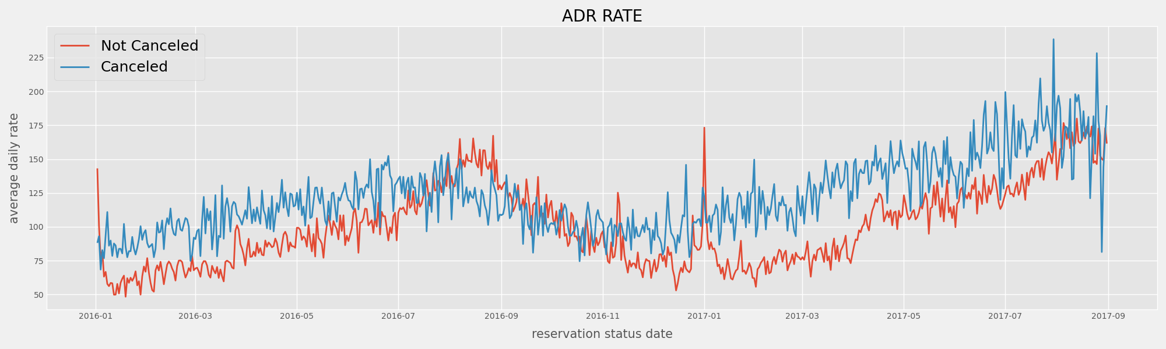
As shown in the graph, cancellations occur more frequently when the average daily rate is high. This supports the previous analysis, confirming that higher prices lead to more cancellations.

Slide 14
Suggestions
Cancellation rates increase as prices rise. To reduce cancellations, hotels can adjust their pricing strategies by lowering rates for specific locations and offering discounts to customers.
Since the cancellation rate is higher in resort hotels than in city hotels, they should consider offering reasonable discounts on weekends or holidays.
In January, when cancellations are highest, hotels can launch marketing campaigns to boost reservations and revenue.
Additionally, improving hotel quality and services, especially in Portugal, can help reduce cancellation rates.

